Slide 1


Large Language Models as Cryptanalysts:
Assessing Decryption Capabilities Across Classical Ciphers
Spring 2025 – American University of Beirut
Course: CMPS396AH— Instructor: Amer Mouawad
Aline Hassan | Zeinab Saad | Hadi Tfaily
1

Slide 2


OUTLINE
Introduction
Background
System Design
Experimental Results
Challenges and Limitations
Future Improvements
Conclusion and Future Work
2

Slide 3





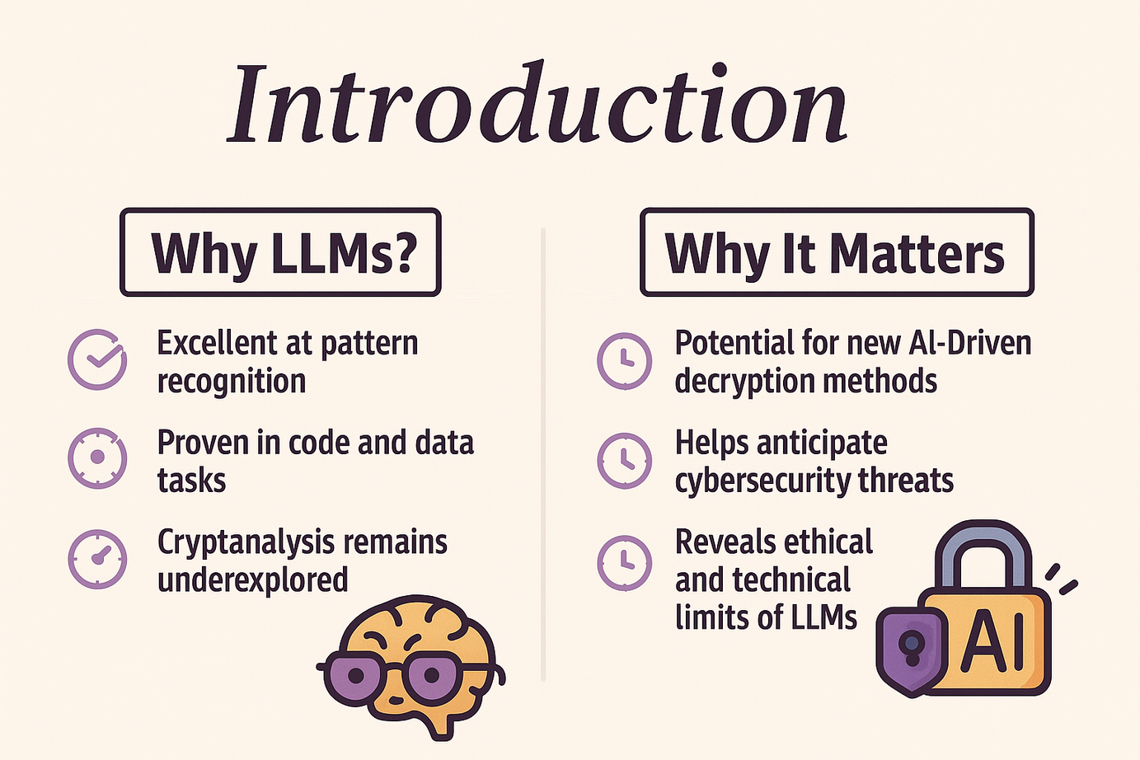

Introduction
Why LLMs?
Why It Matters
Excellent at pattern recognition
Potential for new AI-driven decryption methods
Proven in code and data tasks
Helps anticipate cybersecurity threats
Cryptanalysis remains underexplored
Reveals ethical and technical limits of LLMs
3

Slide 4




Cryptanalysis Overview & History
Why Cryptanalysis Matters
Classical Cipher
Common Attacks
CIA Triad: Confidentiality, Integrity, Availability
Caesar
Known/Chosen Plaintext Attacks (KPA/CPA)
Vigenère
Attacks aim to break encryption and expose vulnerabilities
Brute Force, Side-Channel, Fault Analysis
monoalphabetic
Rail Fence
4

Slide 5


Literature Review
ML in Classical Cryptanalysis
Deep Learning Advances
LSTM, Transformers classify ciphers with ~83% accuracy
ANNs, CNNs improve key prediction
Applied in lightweight ciphers (e.g., S-AES, S-DES)
Detect patterns in substitution/transposition ciphers
5

Slide 6


Literature Review
Generative Approaches (GANs)
LLMs in Cipher Decryption
UC-GAN cracks multiple ciphers without linguistic knowledge
GPT-4/GPT-4o effective in zero-shot decryption
High success on simple ciphers
Struggles with complex encryption & consistency
6

Slide 7



Gap in Existing Research
Research Gap Identified
No existing work fine-tunes LLMs or trains transformers for cryptanalysis
GAP
Opportunity to assess LLMs' active decryption ability
This project bridges the gap with targeted evaluation of LLMs across classical ciphers
7

Slide 8
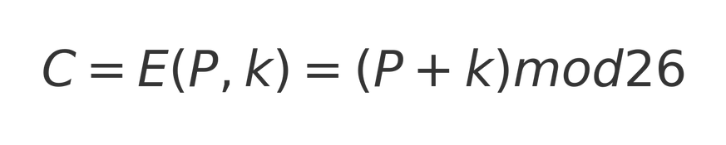
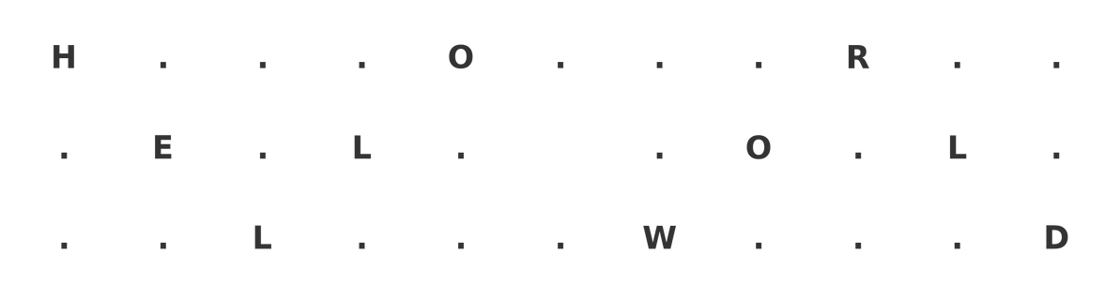
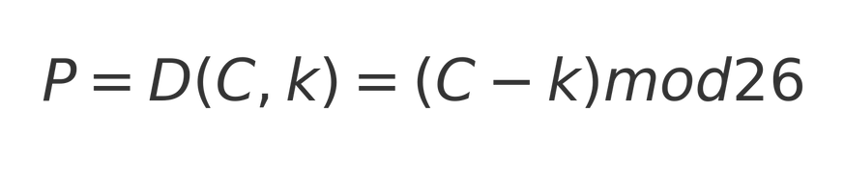

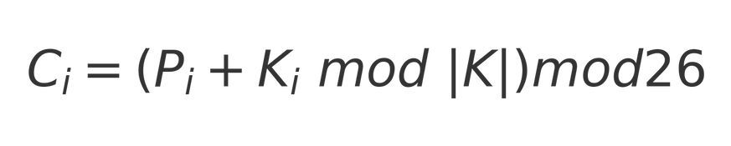
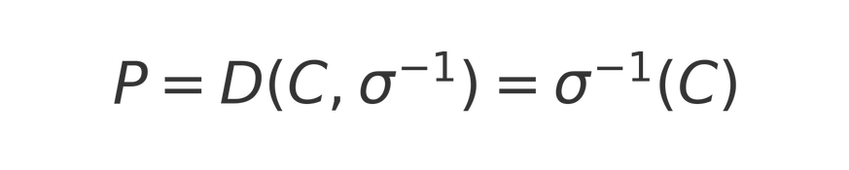
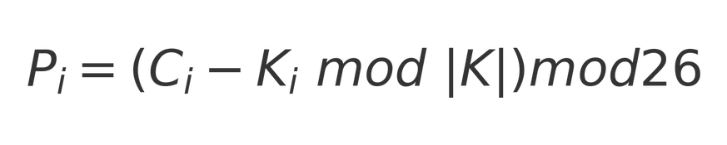
Algorithmic Definitions
Caesar Cipher:
Rail Fence Cipher:
Monoalphabetic Cipher:
Vigen`ere Cipher
8

Slide 9
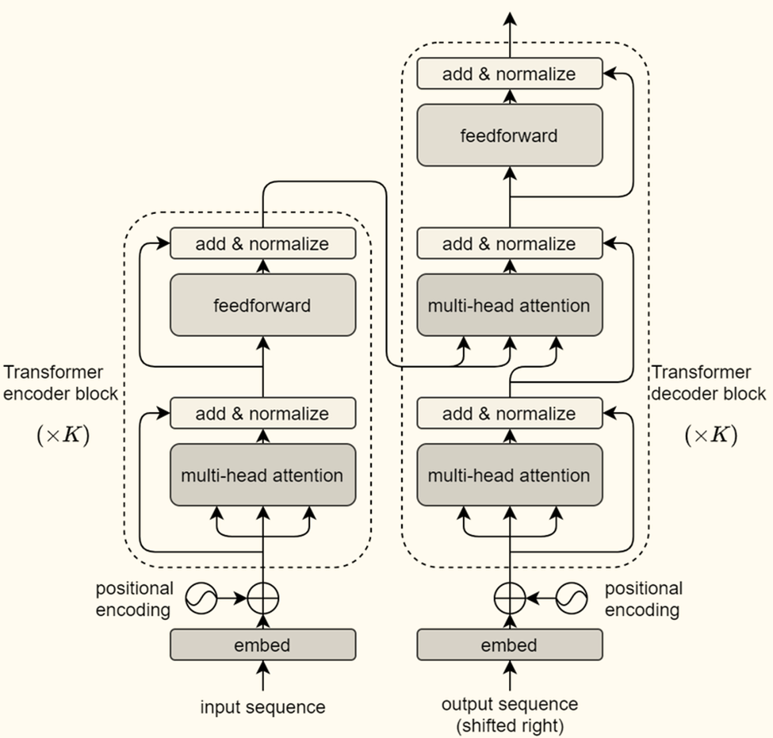
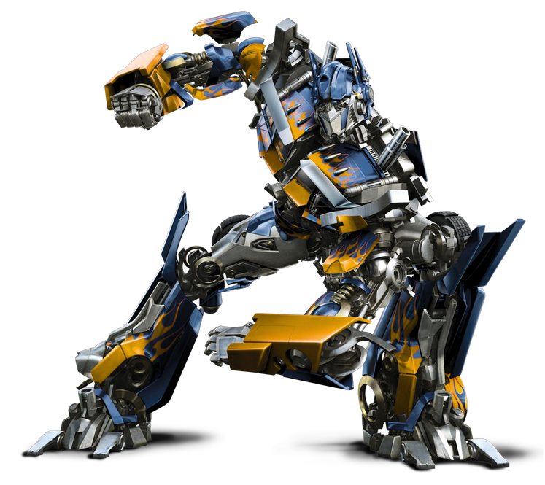

Transformer Architecture
9

Slide 10

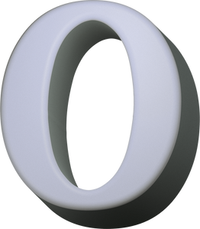





Methodology
STEP
Zero-shot Learning
01
STEP
02
Few-shot Learning
STEP
Finetuning Mistral 7B
03
STEP
Training Vanilla Transformers
04
05
Training Enhanced Transformer
10

Slide 11



Zero-shot Caesar Cipher Evaluation
Zero-shot Setup:
Models: Mistral 7B (local), GPT-O1, DeepSeek-R1
20 Caesar cipher test cases with random shifts (1–25)
Prompt: "Decrypt this Caesar cipher text: [text]..."
Hardware: A100 GPU (local), OpenAI API, web interface
Manual verification, clean ciphertext input
11

Slide 12
Few-shot Caesar Cipher Evaluation
Few-shot Extension:
Same models, hardware, and test set as zero-shot
Prompt includes 3 demonstration pairs (shifts: 1, 3, 4)
Prompt format: Examples + Target Ciphertext + Explanation
Consistent inference parameters (temp=0, max tokens capped)
Randomized example order, blind test ciphertexts
Outputs cross-verified by three reviewers
12

Slide 13

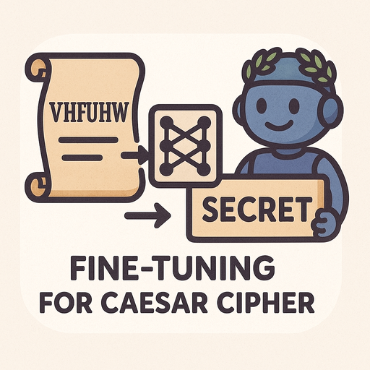
Fine-tuning
Model & Architecture:
Tokenization:
Mistral-7B-v0.3 (decoder-only, autoregressive, 8192-token context)
BPE tokenizer (32k vocab), instruction-response format
Efficient, deterministic, subword-aware
Dataset & Preprocessing
Training Setup
JSONL with natural language prompts and outputs
Preprocessed to 4096 tokens, left-aligned, truncated as needed
Epochs: 5, Batch: 4 × 4, LR: 2e-5
Optimizer: AdamW + FP16 + checkpointing
Evaluated every epoch, logged every 10 steps
13

Slide 14

Transformer
Model Design
Architecture
PyTorch implementation of encoder-decoder transformer
Applies to Caesar, Vigenère, Rail Fence, Monoalphabetic
Uses char-level tokens with <SOS>, <EOS> markers
Sinusoidal position encodings
Multi-head self & cross-attention
256-token fixed-length inpu
Optimization
Hyperparameters tuned with Optuna
Trained with Adam, cross-entropy loss
Dropout, layer norm, checkpointing used
14

Slide 15

Enhanced Transformer for Caesar Cipher
Positional Encoding Innovation
Why It Works
Replaced sinusoidal with learned embeddings
Combined token + position using addition
Learns Caesar-style shift patterns efficiently
Keeps original embedding dimensions
Optimized for stable gradient flow
Data Strategy
Implementation Notes
1M Caesar samples (Google + Tatoeba)
Augmentation: R3 → R1–5 → all 25 shifts
Tokenized at character level (max 256)
Token + Positional + Projection layers
Uses special tokens: <PAD>, <SOS>, <EOS>
Stratified 80/10/10 data split
15

Slide 16
D_MODE
HEADS
LAYERS
D_FF
MAX SEQ
DROPOUT
Caesar (Vanilla)
512
4
6
512
256
0.1103
Caesar (Updated)
512
8
3
1024
256
0.104
Monoalphabetic 1 Key
512
8
6
1024
256
0.1287
Monoalphabetic 5 Keys
512
2
6
256
256
0.2198
Monoalphabetic 100 Keys
512
8
8
256
256
0.1371
Vigen`ere 1 Key
512
8
6
256
256
0.1125
Data Security
Vigen`ere 5 Keys
256
2
6
512
256
0.1021
Vigen`ere 100 Keys
512
8
8
1024
256
0.1019
Rail Fence
256
8
2
512
512
0.1861
16

Slide 17


Caesar Cipher Results
GPT-O1
GPT-O1 achieved 90% accuracy on Caesar cipher decryption with zero-shot prompting, improving to 95% using few-shot examples
DEEPSEEK-R1
DeepSeek-R1 reached 85% accuracy in zero-shot mode and increased to 90% with few-shot guidance
MISTRAL-7B
90%
95%
85%
90%
0%
93 %
Mistral-7B failed to decrypt any Caesar cipher samples correctly, showing 0% accuracy across all conditions.
FINE-TUNED TRANSFORMER:
A fine-tuned transformer achieved 93% accuracy on Caesar cipher tasks, demonstrating effective adaptation through training.
GPT-O1
ZERO-SHOT
GPT-O1
FEW-SHOT
DEEPSEEK-R1
ZERO-SHOT
DEEPSEEK-R1
FEW-SHOT
MISTRAL-7B
FINE-TUNED
17

Slide 18
Caesar Cipher Results
VANILLA TRANSFORMER
(1 OR 13 SHIFTS)
The vanilla transformer perfectly decrypted Caesar cipher messages with 100% accuracy when trained on 1 or 13 fixed shifts.
VANILLA TRANSFORMER
(25 SHIFTS)
When expanded to handle all 25 shift values, the vanilla transformer's accuracy dropped slightly to 91.15%.
100%
91.15%
99.75%
ENHANCED TRANSFORMER
The enhanced transformer achieved 99.75% overall accuracy and 99.9% character-level precision on Caesar cipher tasks, effectively handling all 25 shifts through improved architecture and training.
TRANSFORMER
1 OR 13 SHIFTS
TRANSFORMER
ALL SHIFTS
ENHANCED TRANSFORMER
ALL SHIFTS
18

Slide 19
Monoalphabetic Cipher Results
1 KEY
With a single substitution key, the vanilla transformer achieved 97.93% sample accuracy and 98.87% character-level precision, indicating strong pattern learning.
5 KEYS
Expanding to five substitution keys slightly lowered sample accuracy to 97.25% while improving character precision to 99.62%, showing stable generalization.
100 KEYS
A fine-tuned transformer achieved 93% accuracy on Caesar cipher tasks, demonstrating effective adaptation through training.
97.93%
97.25 %
29.225%
1.3%
1000 KEYS
At 1000 random substitution keys, the model’s sample accuracy collapsed to 1.3% and character accuracy to 32%, highlighting the infeasibility of learning arbitrary mappings at scale.
1 KEY
5 KEYS
100 KEYS
1000 KEYS
19

Slide 20
Vigenère Cipher Findings
1 KEY
Using a single keyword, the model achieved 97.7% sample accuracy and 99.12% character-level precision, showing strong learning of periodic shifts.
5 KEYS
With five keywords, accuracy dropped modestly to 93.725% sample-level and 98.58% character-level, maintaining reliable pattern recognition.
97.7%
93.73 %
0%
0%
100 KEYS
With 100 keywords, the model dropped to 0% sample accuracy and 32.55% character precision, struggling with key periodicity and mapping.
1000 KEYS
At 1000 keywords, the model failed entirely, scoring 0% sample accuracy and just 2% character precision due to compounding challenges in key periodicity and mapping.
1 KEY
5 KEYS
100 KEYS
1000 KEYS
20

Slide 21
Rail Fence Cipher Results
RAIL FENCE
Across varying rail counts, the model achieved 99.15% accuracy, consistently decoding the geometric zigzag pattern due to its deterministic structure.
99.15%
RAIL FENCE
21

Slide 22
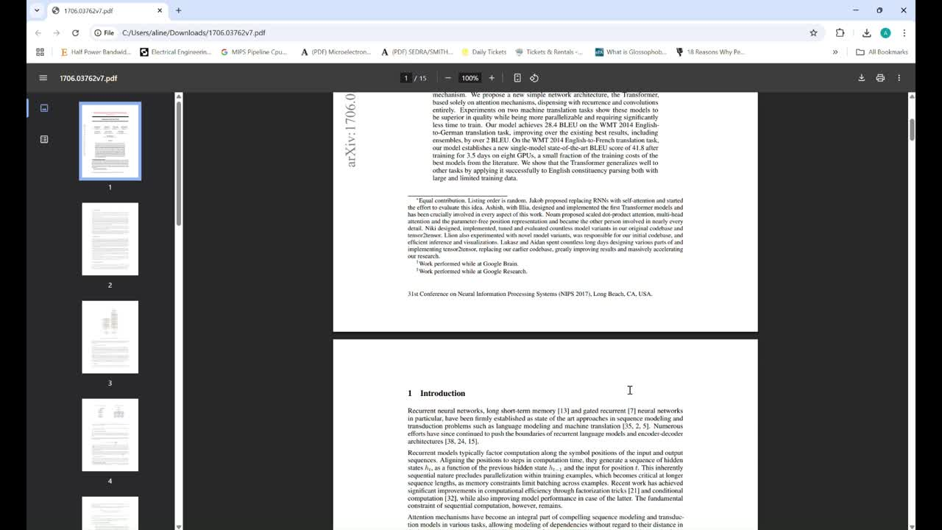

Slide 23


Challenges and Limitations:
Computational Constraints
Runtime limits: 6h HPC / 24h Colab capped training duration.
Intractable key spaces: 26! (monoalphabetic), 26ⁿ (Vigenère) exceeded compute capacity.
Small batch sizes: Limited to 128 due to GPU memory constraints
Long training times: 3.2 hours/epoch for 1000-key tasks made full tuning infeasible.
Sequence limit: 256 tokens max due to O(n²) attention scaling.
23
16

Slide 24

🔧 FUTURE IMPROVEMENTS
🖥️ Hardware Scaling:
🧠 Algorithmic Enhancements:
Use 4×A100 GPUs for high-key ciphers.
Update Embedding, & Attention Type
⚙️Data Pipeline Optimization
🚀Combined Strategy
On-the-fly cipher gen, binary format, cached attention.
Hardware + smarter algorithms + faster data = breakthrough capability
25

Slide 25

CONCLUSION AND FUTURE WORK
Transformers excel at structured ciphers: Rail Fence (98.97%), Caesar (99.75%).
Fail on complex substitution: Monoalphabetic (1.3%), Vigenère (0%).
Limitations: No arithmetic reasoning, poor long-range pattern handling.
Future: Extends to more complex encryption techniques
26

Slide 26


Thank You!!
27

